Slide 1


ANDROID project- newzy app
Rimjhim Kumari
Roll-09
L

Slide 2
Contents
1. Introduction
2. Splash Screen
3.Login Page
4.Registration Page
5.Welcome Page
6.News Feed Home Page
7.Different Categories Page
8.Conclusion

Slide 3

INTRODUCTION
Newzy App- This app is related to show all current news of different fields like technology, science, sports, Health, Entertainment etc.
It also consist weather report of different places and show all report related to weather like temperature, Humidity, Wind speed, Pressure etc.

Slide 4
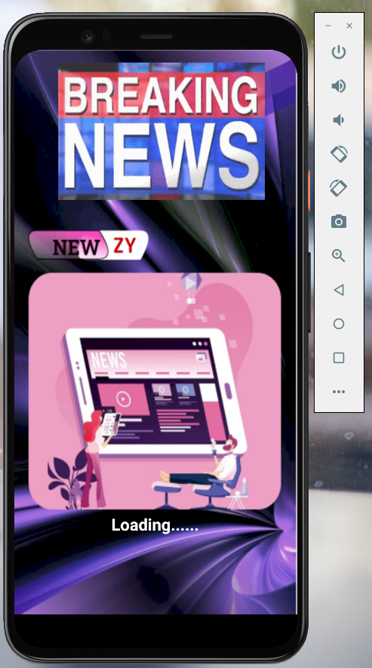
Splash screen

Slide 5
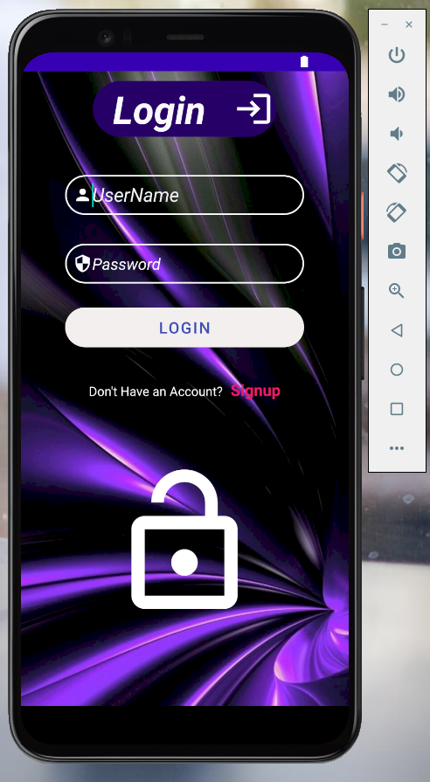
LOGIN PAGE

Slide 6
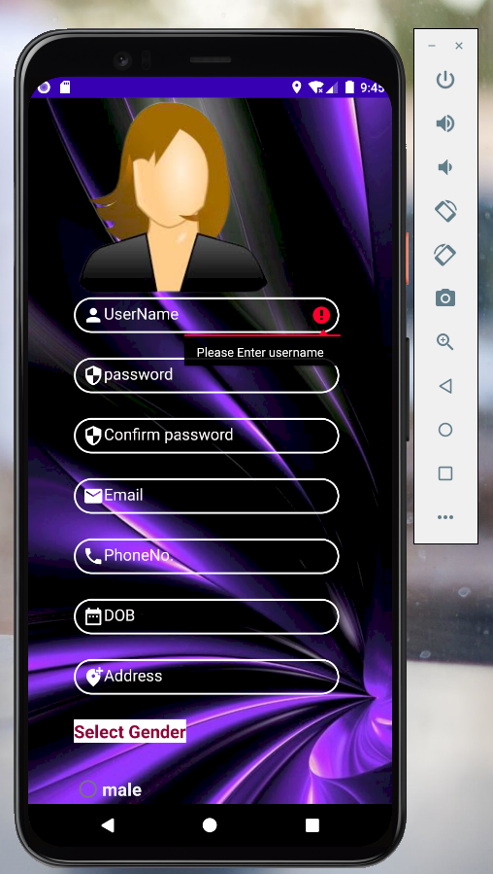
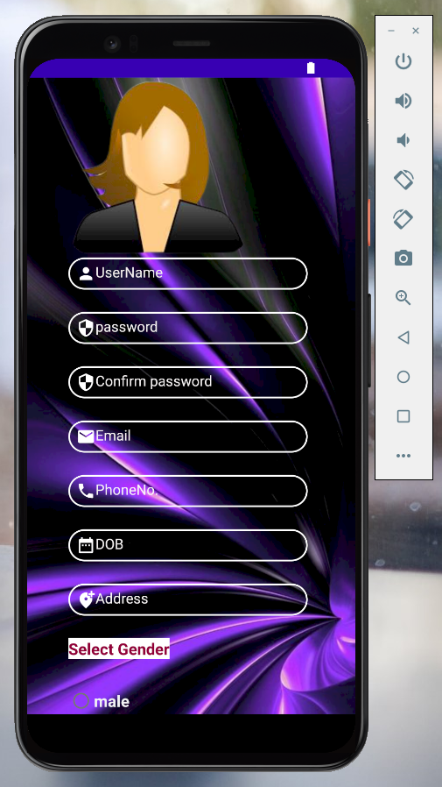
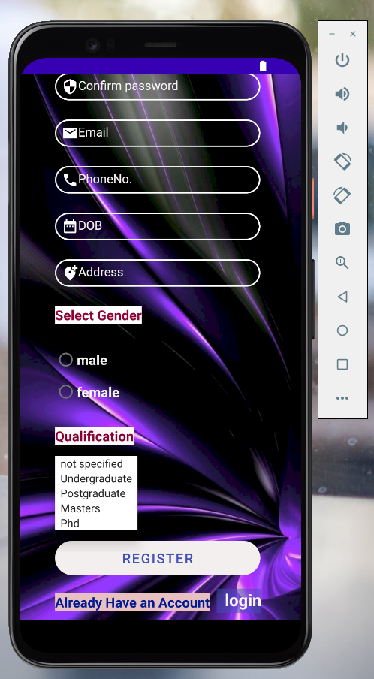
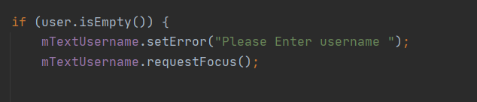
Registration Page

Slide 7
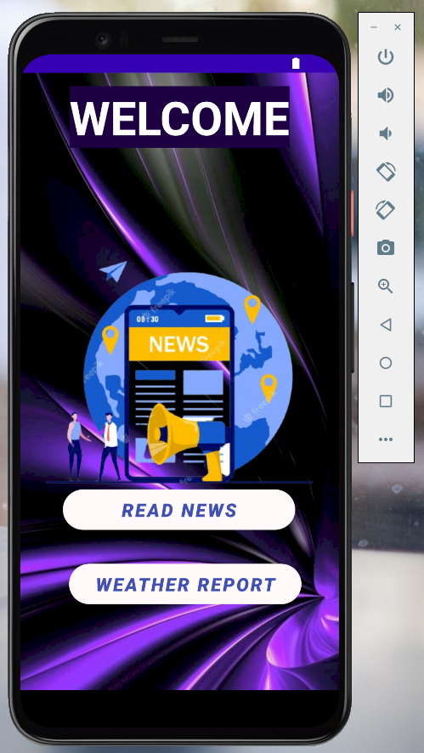
Welcome Page

Slide 8
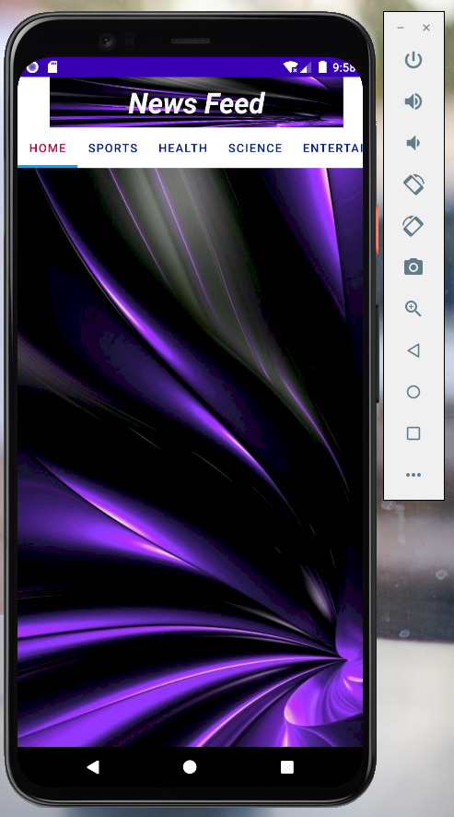

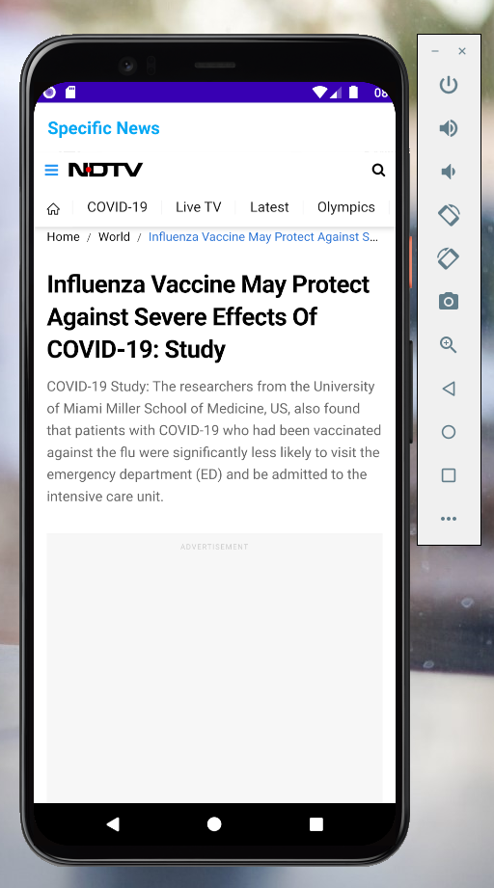

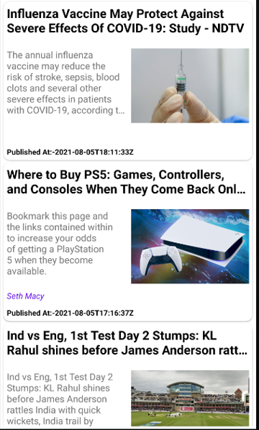
News Feed home page

Slide 9
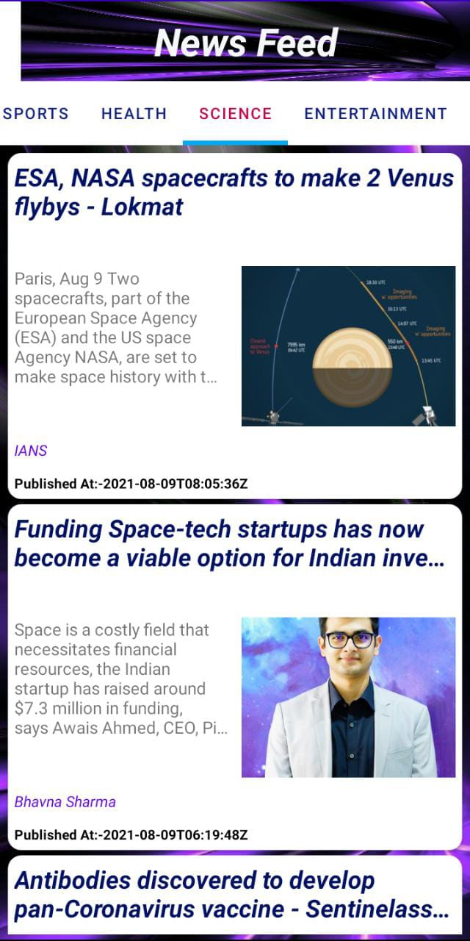
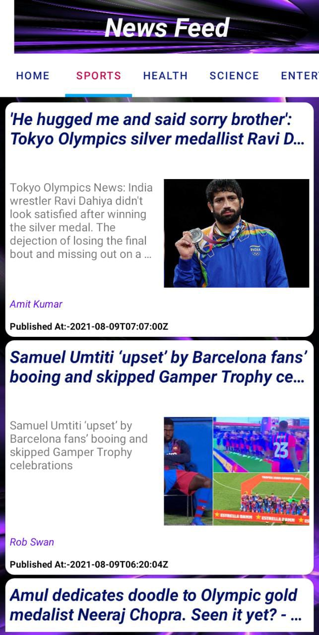

Category wise pages

Slide 10


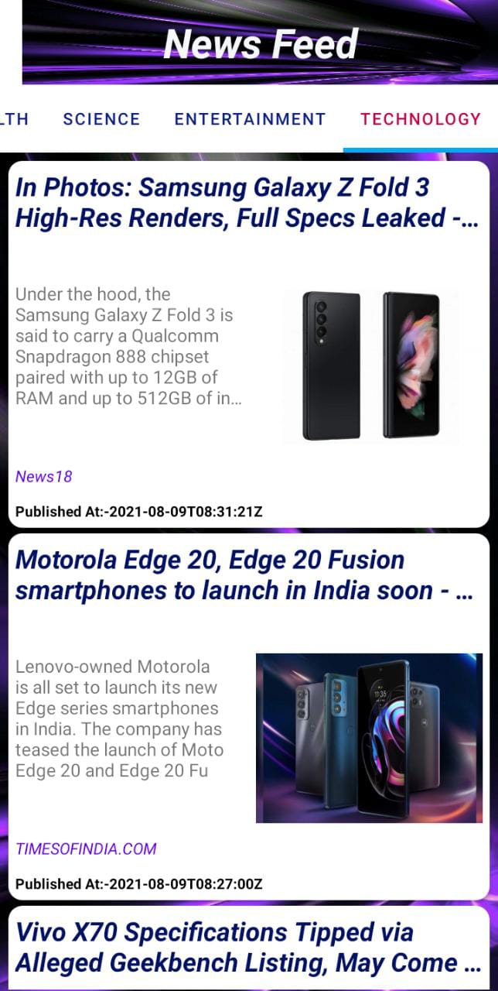

Slide 11
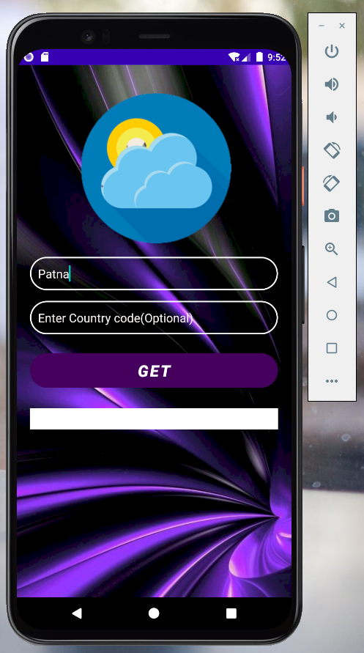
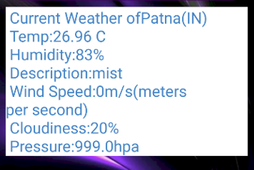
Weather Report

Slide 12
CONCLUSION
In short, The purpose of the project is to develop an application which display news articles related to different fields and also weather report of different places.

Slide 13
THANK YOU

